Slide 1
Rainer Stropek | time cockpit
C#-Revolution

Slide 2

Your Host
Rainer Stropek
Developer, Entrepreneur
MVP for Azure, MVP for Dev Technologies, MS Regional Director, Trainer at IT-Visions
Contact
software architects gmbh rainer@timecockpit.com Twitter: @rstropek

Slide 3
Agenda
C# und .NET machen einen radikalen Wandel durch. Open Source, Plattformunabhängigkeit, grundlegendes Redesign, neue Compilerplattform – als C#-Entwicklerinnen und -Entwickler gibt es viel Neues zu lernen. Der BASTA!-C#-Workshop von Rainer Stropek ist eine gute Gelegenheit, sich einen Tag Zeit zu nehmen, um auf den neuesten Stand zu kommen. Im Workshop werden unter anderem folgende Themen behandelt:
Neuerungen in C# und Visual Studio
Die neue .NET Runtime
dotnet CLI
Die neue .NET-Ausführungsumgebung
Anwendungsbeispiele in ASP.NET Core (Fokus liegt auf der Sprache und .NET-Grundlagen, nicht auf ASP.NET)
Neue Tools und Libraries.
In der bewährten Art und Weise wird sich Rainer Stropek im Workshop auf Codebeispiele statt Slides konzentrieren.

Slide 4
Cloud-first, cloud-only, SaaS for devs (VSTS)
Revenue
Focus on Cloud (IaaS, PaaS, aPaaS, SaaS)
Costs
Redesign .NET for modularity („a la carte“)
Visual Studio Code
Visual Studio is not enough
Command line interfaces
Have a cross-platform solution
Enhancements to Windows for devs
Ubuntu subsystem for Win
Xamarin
Compete
Redesign .NET
Compiler
Make all dev tools and frameworks Open Source
CLR
.NET Foundation
Framework
Great Git support, GitHub

Slide 5
.NET Core

Slide 6
Why .NET Core?
Refactor .NET Framework
Establish a Standard Library for the various incarnations of .NET .NET Core is not 100% compatible with .NET 4.x (details)
Make it a real cross-platform solution
Windows, Mac OS, Linux (details in .NET Core Roadmap)
Make it open source
A .NET Foundation project
MIT License
Details: https://docs.microsoft.com/dotnet/

Slide 7
Components of .NET Core
.NET Runtime (CoreCLR)
CoreCLR includes Base Class Library (BCL)
.NET Core Foundation Libraries (CoreFX)
.NET Command Line Tools (.NET CLI)
Including the dotnet application host
Cross-Platform Compiler (Roslyn)

Slide 8
Status of .NET Core
.NET Core 1.1 is RTM
Download current version
2.0 is scheduled for Summer 2017 (roadmap, overview in docs)
Visual Studio Tools are in preview
Wait for VS2017 (March 2017)
C# is RTM
VB and F# are coming
X64 Support
X86, X64 support on Windows
X64 support on many Linux distros
See also: https://github.com/dotnet/core/blob/master/roadmap.md

Slide 9
What can you build?
Console applications
ASP.NET Core applications
UWP applications
Xamarin Forms applications
See also: https://github.com/dotnet/core/blob/master/roadmap.md

Slide 10
Where to get .NET Core?
.NET Core landing page
With Visual Studio tools (Visual Studio prerequisites)
Command-line tools (with your own editor, e.g. VSCode, download)
.NET Install Script (details, download)
You have to care for the prerequisites
NuGet
Packages and Metapackages
Docker: microsoft/dotnet image (details)
.NET Core Source Browser
See also: https://github.com/dotnet/core/blob/master/roadmap.md

Slide 11
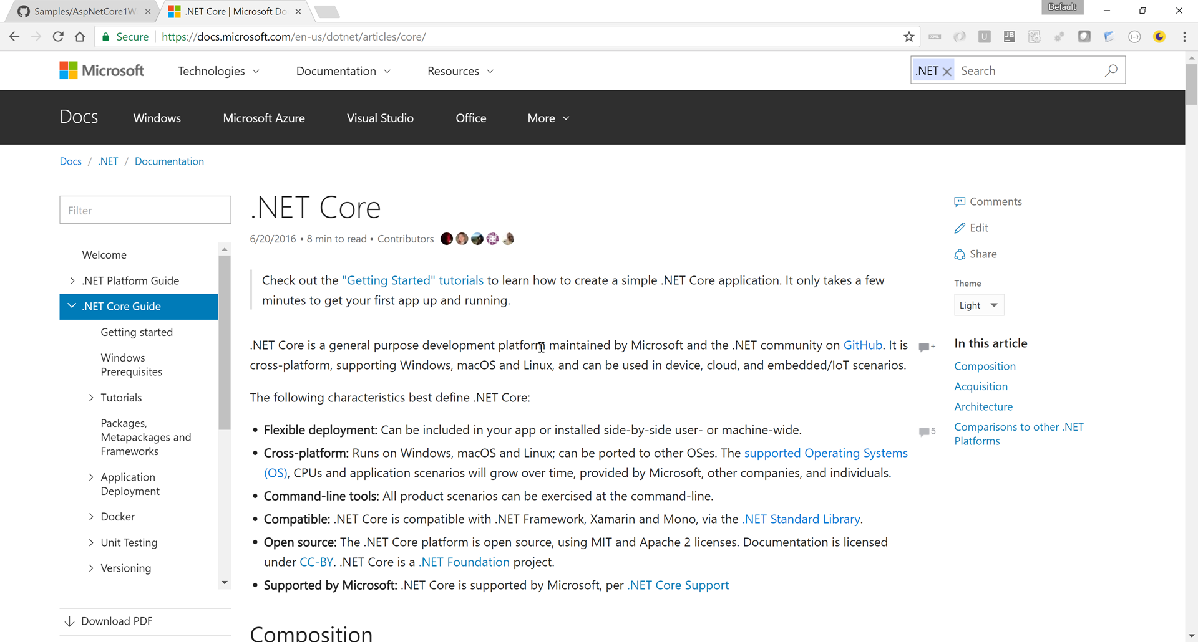
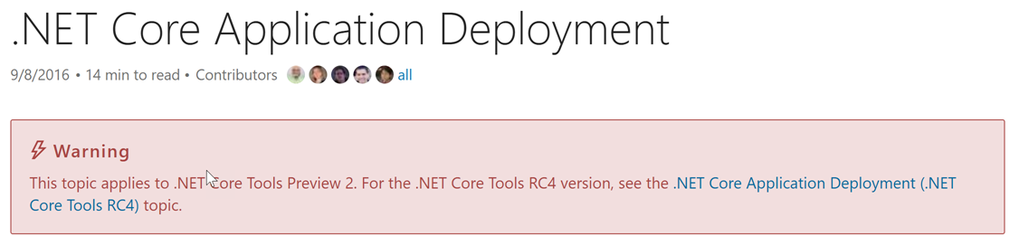
Getting Help
New https://docs.microsoft.com

Slide 12
Packages, Metapackages and Frameworks
Create console app with CLI
Analyze .csproj
Discuss .csproj reference
Run app
Further readings
More about cross-platform libraries
MSBuild Project File Schema Reference
Creating new templates
https://github.com/rstropek/Samples/tree/master/AspNetCore1Workshop/10-console-hello-world

Slide 13
.csproj
<Project Sdk="Microsoft.NET.Sdk">
<PropertyGroup>
<OutputType>Exe</OutputType>
<TargetFramework>netcoreapp1.1</TargetFramework>
</PropertyGroup>
</Project>
<Project Sdk="Microsoft.NET.Sdk">
<PropertyGroup>
<TargetFramework>netstandard1.6</TargetFramework>
</PropertyGroup>
</Project>
For executable, not present for class libraries
Target Framework (1.0 or 1.1)
Class library based on .NET Standard 1.6
See also MSBuild Project File Schema Reference

Slide 14
Solutions
Create solution: dotnet new sln
Add proj.: dotnet sln add …
Create solution in VS2017
.NET Standard class library with Json.NET
.NET Framework console app with reference
Further readings
.NET Core Tools MSBuild
https://github.com/rstropek/Samples/tree/master/AspNetCore1Workshop/25-project-references

Slide 15
Cross-platform
Run app on Linux using Docker

Slide 16
.NET CLI

Slide 17
.NET Core CLI
dotnet command
new – create project
migrate – migrates from Preview 2 to RC4 (project.json → .csproj)
restore – restore dependencies
run – run source code without explicit compile
build – builds project and dependencies
test – runs unit tests
pack – packs code into a NuGet package
publish – packs the app and dependencies for publishing
https://docs.microsoft.com/en-us/dotnet/articles/core/preview3/tools/index

Slide 18
dotnet run
Run application from the source code
Use dotnet without any command to run a built DLL
Uses dotnet build in the background
Important parameters
--framework
--configuration <Debug|Release>
https://docs.microsoft.com/en-us/dotnet/articles/core/preview3/tools/dotnet-run

Slide 19
Deployment (dotnet publish)
Framework-dependent deployment
Shared system-wide version of .NET Core must be present on target system
DLLs are launched using dotnet
DLLs are portable
Self-contained deployment
No prerequisites on target system necessary
Does not contain native prerequisites
Results in an platform-specific executable
Optional: Use CrossGen for native image generation
https://docs.microsoft.com/en-us/dotnet/articles/core/preview3/deploying/index

Slide 20
Self-contained Deployment
Create self-contained sample
See following slides
Build and publish SCD
dotnet publish -c release
dotnet publish -c release -r win10-x64
dotnet publish -c release -r debian.8-x64
Runtime Identifier (RID) (details)
Release instead of debug version (need not ship PDBs)
https://github.com/rstropek/Samples/tree/master/AspNetCore1Workshop/27-self-contained

Slide 21
Self-contained Deployment
<Project Sdk="Microsoft.NET.Sdk">
<PropertyGroup>
<OutputType>Exe</OutputType>
<TargetFramework>netcoreapp1.1</TargetFramework>
</PropertyGroup>
<PropertyGroup>
<RuntimeIdentifiers>win10-x64;debian.8-x64</RuntimeIdentifiers>
</PropertyGroup>
<ItemGroup>
<PackageReference Include="Newtonsoft.Json" Version="9.0.1" />
</ItemGroup>
</Project>
Details: https://docs.microsoft.com/en-us/dotnet/articles/core/rid-catalog

Slide 22
Versioning

Slide 23
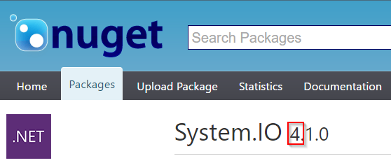
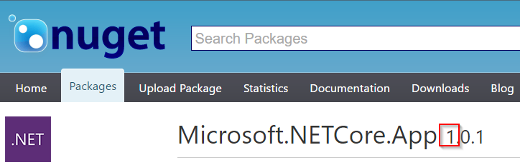
Versioning
Framework version changes when APIs are added
No implementation → no patch numbers
Example: netcoreapp1.0
Package versions
System.* packages use 4.x numbers (overlap with .NET Framework)
Packages without overlapping with .NET Framework → 1.x
https://docs.microsoft.com/en-us/dotnet/articles/core/versions/index

Slide 24
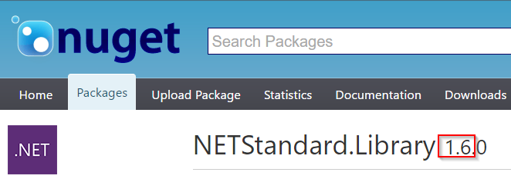
Versioning
.NET Standard Library
Versioning independent of any .NET runtime, applicable to multiple runtimes
1.6 for .NET Core 1.0
Examples
https://docs.microsoft.com/en-us/dotnet/articles/core/versions/index

Slide 25
Libraries

Slide 26
Libraries
Shared files
Libraries
Creating NuGet packages
dotnet pack
Further readings
More about cross-platform libraries
Tools for porting code from .NET Framework

Slide 27
.NET Standard Library

Slide 28
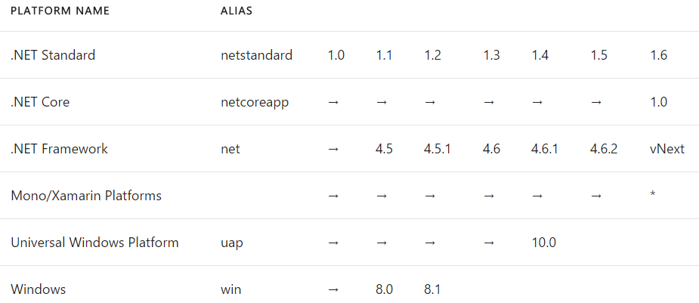
Why a standard library?
CLR (CLI) has already been standardized (ECMA 334)
No standardized BCL prior to .NET Core
Goal: Standard BCL API for all .NET platforms
Easier to create portable libraries
Reduce conditional compilation
What about PCLs?
Well defined API instead of just intersection of platforms
Better versioning
Overlapping PCL profiles (details)
Details: https://docs.microsoft.com/en-us/dotnet/articles/standard/library

Slide 29
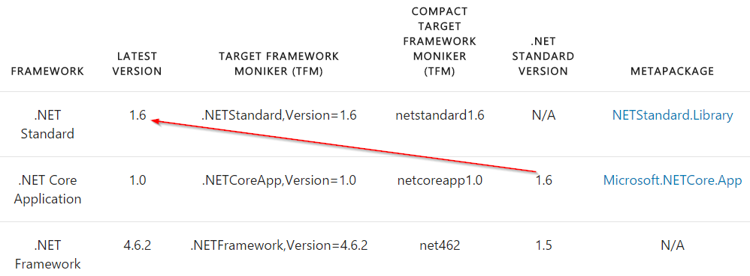
.NET Standard Library
Standard APIs defined as empty C# classes
Example: ref folder in System.Runtime
NETStandard.Library (NuGet)
Metapackage for .NET Standard Library
Details: https://docs.microsoft.com/en-us/dotnet/articles/standard/frameworks

Slide 30
ASP.NET Core 1 Basics
Practical use of .NET Core

Slide 31
Minimal ASP.NET Core 1
ASP.NET Pipeline
Discuss “a la carte” framework
Add static files (sample)
Kestrel
Windows, Linux with Docker
Visual Studio Code
Further readings
Building middlewares
https://github.com/rstropek/Samples/tree/master/AspNetCore1Workshop/50-simplest-aspnet

Slide 32
Walkthrough VS “File – New – Project”
Create web project in VS2015
Walkthrough
Servers (IIS and Kestrel)
Environments
Adding MVC

Slide 33
101 for ASP.NET Core 1
Application Startup
Main Method
Startup class with ConfigureServices (DI) and Configure (Pipeline)
Static Files
Environments
Servers
IIS, Kestrel

Slide 34
Configuration
No web.config anymore
Key/value pair settings from different providers
E.g. memory, environment variables, JSON, INI, XML
Extensible
Details about writing custom providers
Options pattern for DI integration

Slide 35
Configuration
In-memory configuration
JSON configuration
Configuration via command line
Configuration with environment variables
Options pattern
See practical use in AppInsights
https://github.com/rstropek/Samples/tree/master/AspNetCore1Workshop/55-configuration/

Slide 36
Logging
Support for logging built into ASP.NET Core
Various logger built in
E.g. console, NLog
Details about logging
Consider using Application Insights
Getting started with AppInsights in ASP.NET Core

Slide 37
Logging
JSON file to configure logging
.NET Core Logging
AppInsights
Custom logging
AppInsights portal
https://github.com/rstropek/Samples/tree/master/AspNetCore1Workshop/58-logging/

Slide 38
Dependency Injection
Support for DI built into ASP.NET Core
Details about DI
Framework-provided services and your own services
Service Lifetime
Transient, Scoped, Singleton, Instance
Default container can be replaced (details)

Slide 39
Dependency Injection
Setting up DI
Service Lifetime
https://github.com/rstropek/Samples/tree/master/AspNetCore1Workshop/60-di-scopes/

Slide 40
.NET Core Automation
Test, build, and release automation

Slide 41
CI with .NET Core apps
VSTS supports building and publishing .NET Core apps
Details
Azure App Services supports .NET Core apps
Kudu-support for .NET Core
Ready-made Docker image with Dockerfile
microsoft/dotnet

Slide 42
Build Automation
Build and deploy .NET Core in VSTS
https://www.visualstudio.com/en-us/docs/build/apps/aspnet/aspnetcore-to-azure

Slide 43
Dockerfile for .NET Core app

Slide 44
Unit Testing
.NET Core supports multiple test frameworks
E.g. XUnit, MSTest
Compare XUnit and MSTest

Slide 45
Unit Testing
Create and run library with tests
XUnit (sample)
MSTest (sample)
Run tests with VSTest.Console.exe
vstest.console.exe project.json /UseVsixExtensions:true /logger:trx
Project setup
Folders, project.json
https://blogs.msdn.microsoft.com/visualstudioalm/2016/09/01/announcing-mstest-v2-framework-support-for-net-core-1-0-rtm/

Slide 46
C# 7
Live Coding; sample code see https://github.com/rstropek/Samples/tree/master/CSharp7

Slide 47
Thank you for coming!
Questions?

